Slide 1
Test Trend Analyzer
Prototype – Showcase!!

Slide 2
Generic Problem Statement
“I want to know the relative health of all my projects in an automated fashion.”

Slide 3


Some Personas
QA Manager
A TWer
Tech-Ops Member

Slide 4
Detailed Problem Statement
QA Manager for Enterprise ABC Corp. says…
“I want to know the relative health of all my projects without having to collate the data manually.
It would be great if I could get these aggregation/comparision reports with real-time data automatically.”

Slide 5
What we intended to accomplish??..

Slide 6
Ta-Da!!
What we Thought would Work is….
Simple, easy-to-use tool - upload bulk xml files.
Parse data - line graphs % of tests passed v/s date range.
Enter - start and end date for the plot.

Slide 7
Live Demo
Enter all project metadata to create a new project.
Upload 4, junit.xmls containing, zip files successfully.
View the successfully uploaded project metadata and test records in the respective DB tables.
Proceed to View Reports in the form of line charts for the test records entered and filter it by selecting the requisite date range.

Slide 8
What Next???
Improvising the current application in terms of UX, layout & eradicating all bugs.
Incorporating the General, Upload Abilities and Visualizations oriented Backlog in terms of added functionalities such as:-
export abilities
mailing links
array of visuals for single & multiple projects
automating the upload of xmls
looking at alternatives to Flotcharts – Highcharts,D3, etc.
https://trello.com/board/tta/507d226b919f37f2095396fb

Slide 9
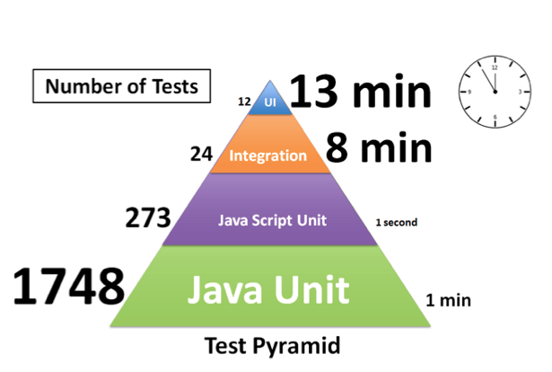
For A TWer

Slide 10
For Tech-Ops

Slide 11
Some More Visuals…For a Single Project

Slide 12
For Multiple Projects-in OVE

Slide 13
Any Questions??
Feedback Please!!
Thank-You
&
Have A Nice Day…☺

